Slide 1
Final project: Modeling stock Market Behavior
Anurag Aiyer, Christopher lee, Matthew Waring

Slide 2
Data Background
Goal
Build a model of how stock prices vary over a year, from a starting price
Project Design:
Build a Markov chain with stationary distribution based on historical data
Compare distribution of Markov chain with the distribution of a test set of stock prices
Methodology was developed by Landauskas and Valakevicius (2011)

Slide 3

Data Background CONT'D
Data
2014-2019 Dow Jones stock closing prices (1007 points per symbol)
30 symbols
Notes:
We are using 2014-2019 data for each stock within Dow Jones to project future forecasts on returns for the next 5 years
To gain a better on the underlying distribution of the data, we specifically looked at the histogram of the closing prices for each stock
For data preprocessing, we decided to normalize the data using the starting 2014 opening price and apply a log scale after normalizing the data
Note that the stocks are the members of the Dow Jones Industrial Average as of 4/1/2024

Slide 4
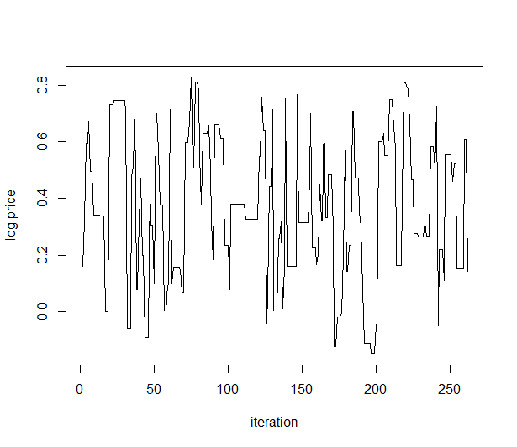
Computational design
Building the Markov Chain
Metropolis-Hastings
Evaluating Markov Chain predictions:
Markov Chain stationary distribution
histogram method
Comparison with observed data:
daily closing prices from 2023-2024

Slide 5
Metropolis HasTings
An MCMC method to obtain random sample variates from target distribution f
After accepting or rejecting samples, the resulting sequence is approximating the target distribution
Notes:
We first generate a candidate samples from the proposal distribution, we used the normal distribution as our proposal
We either reject these samples or add them to a sequence of samples based on the MH Ratio

Slide 6
NORMAL KERNEL ESTIMATION
Kernel estimation: nonparametric method of estimating the density of a random variable.
We estimated the target distribution using daily closing prices and the normal distribution as the kernel.
Notes:
Metropolis Hastings is an acceptance/rejection method in which a markov chain is generated with variates from target distribution f by creating variates from proposal distribution g
Our goal with metropolis hastings is to avoid large acceptances or rejections
In the next slide, we will discuss more about how we are using the proposal distribution for generating future stock prices
We find out that with our generated markov chain, that we have ergodic properties which means that our markov chain has a unique and limiting stationary distribution

Slide 7

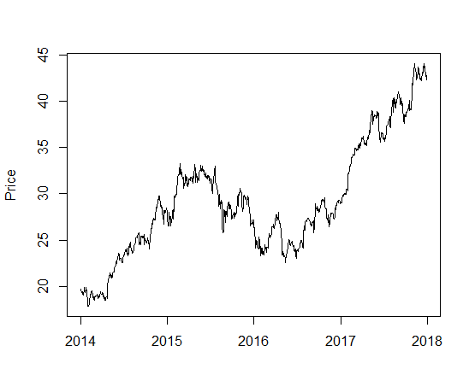
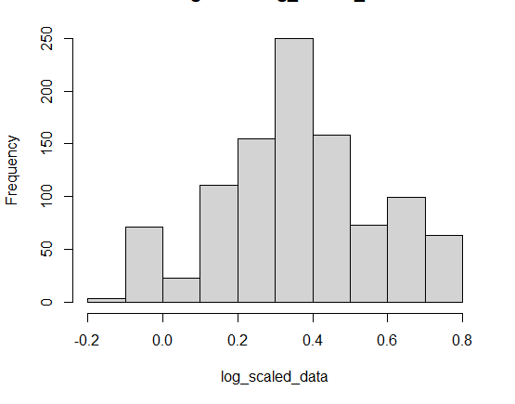
Results: AAPL
Prices vary $17-$44
Prices scaled to starting price and log-transformed
0 = starting price
1 = 2.78 * starting price

Slide 8
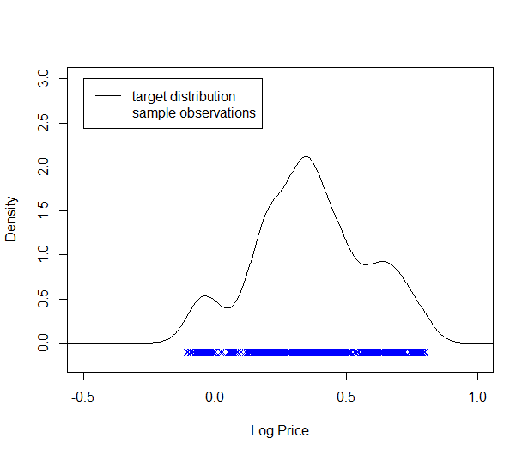
MCMC Target distribution
Kernel density estimator with historic data
Gaussian kernel
Several bandwidths tested

Slide 9
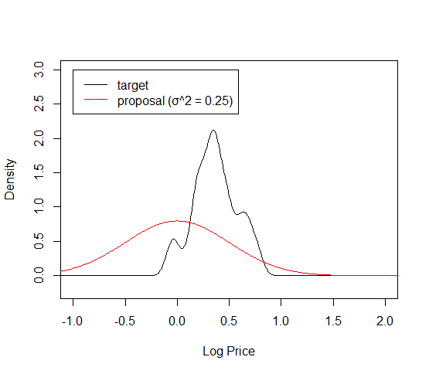
McMC proposal distribution
Normal distribution
Several variances tested

Slide 10
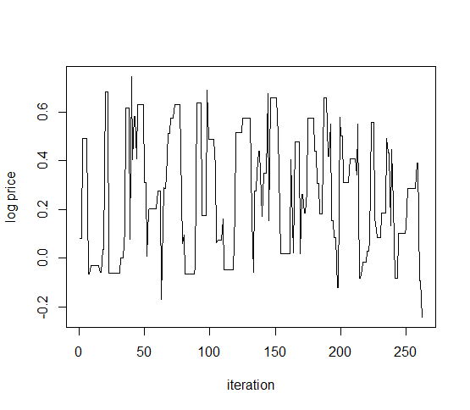
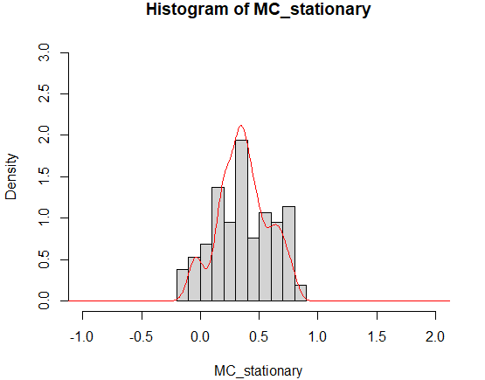
Markov Chain
First 10,000 samples removed
Markov chain histogram follows target distribution

Slide 11
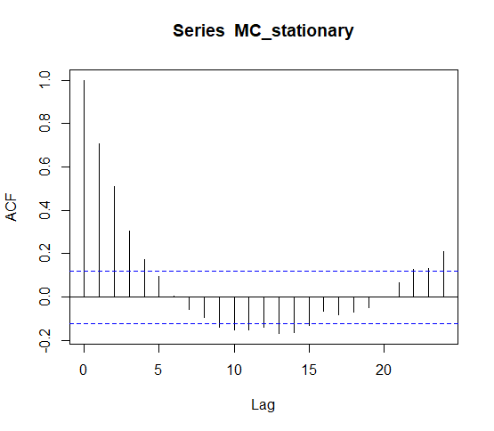
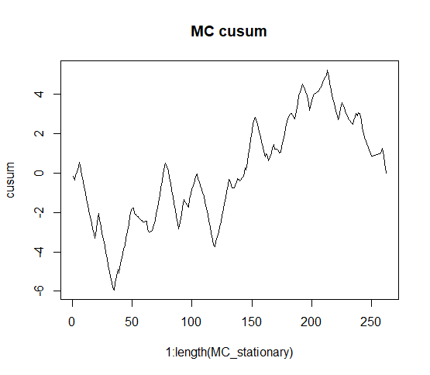
Mc mixing and convergence
Strong effect of proposal distribution variance
Good mixing and convergence at variance = 0.25
Increasing variance:
more flat segments in path
increases autocorrelations
Decreasing variance:
longer ‘burn-in’ period
also increases autocorrelations

Slide 12
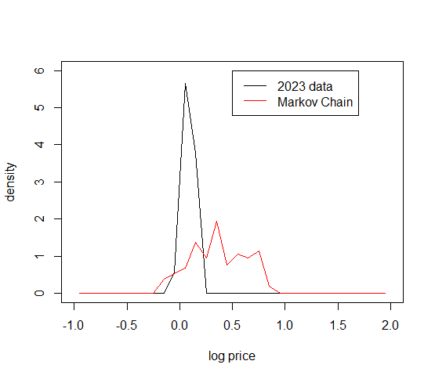
Prediction of new prices
Stock prices from 2023
262 points
scaled to the starting price, and log-transformed
Comparison of 2023 data and Markov Chain Histograms
Δ=Σ|bincount observed – bincount Markov|
Lower Δ -> better performance (lower error)
Notes:
L1 norm of histogram errors

Slide 13
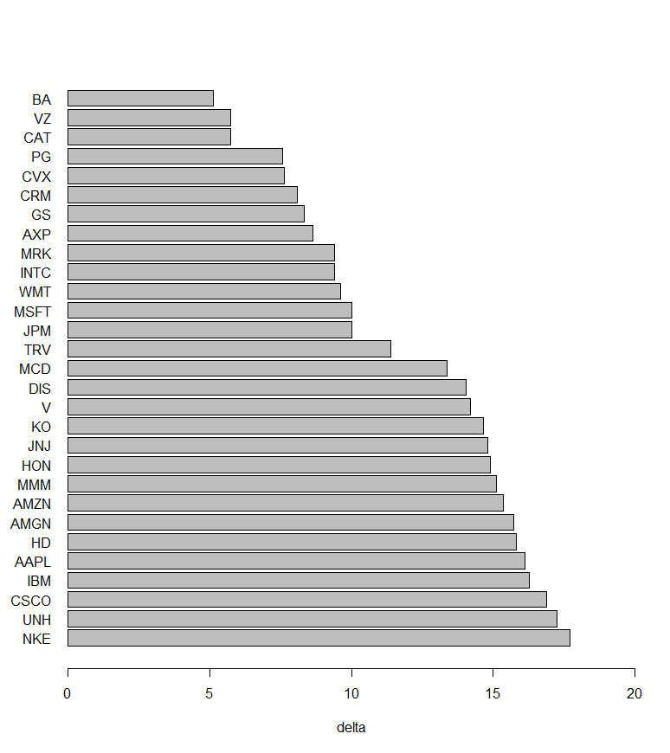
Performance by stock
Delta values varied considerably among stocks
-> Markov Chain models the distribution of prices better for some stocks than others

Slide 14
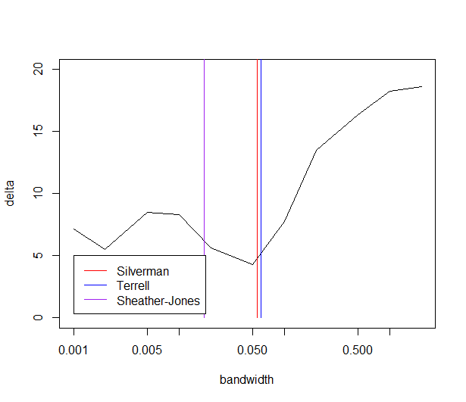
Effect of kernel bandwidth
Tested Markov chains using kernel bandwidths of 0.001, 0.002, 0.005, 0.01, .02, .05, 0.1, 0.2, 0.5, 1, 2
Deltas increased at bandwidths > 0.2

Slide 15
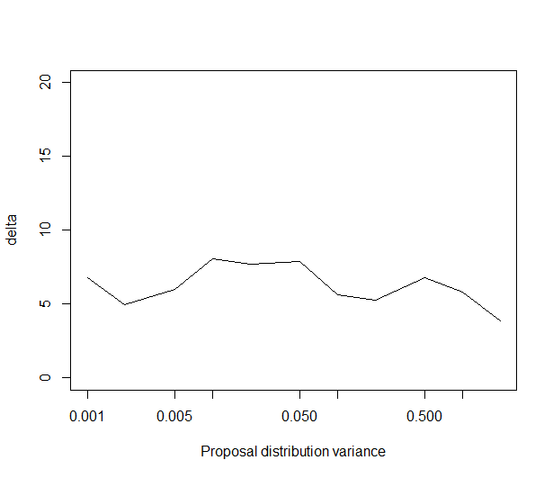
Effect Of proposal distribution variance
Tested Markov chains using variances of 0.001, 0.002, 0.005, 0.01, .02, .05, 0.1, 0.2, 0.5, 1, 2 for proposal distribution
Delta was not sensitive to proposal distribution variance

Slide 16
Conclusions
A distribution of stock prices can be estimated from historical price observations, using a kernel estimator
Metropolis-Hastings can generate a Markov Chain with a target stationary distribution
Markov Chains predicted behavior of some Dow Jones stocks better than others
Proposal distribution bandwidth strongly affects mixing and convergence of Markov Chains, but not prediction accuracy of stock prices

Slide 17
References
Landauskas , M. (2011) ‘Modelling of Stock Prices by Markov Chain Monte Carlo Method’, Intellectual economics, 5(2).
Dar, G. F., Padi, T. R., & Rekha, S. (2022). STOCK PRICE PREDICTION USING a MARKOV CHAIN MODEL: a STUDY FOR TCS SHARE VALUES. Advances and Applications in Statistics, 80, 83–101. https://doi.org/10.17654/0972361722068
Darbinyan, Hayk. (2020). Forecasting of a market trend using the Markov Chain Model.

